Slide 1

Authentication on mwater
This user guide will help you with the authentication process on the mWater Plateform

Slide 2
mWater
TABLE OF CONTENT: 1. FIRST STEP Page 3-5
2. SIGNUP PROCESS Page 6-10
3. LOGIN PROCESS Page 11-14
4. PASSWORD CHANGE PAGE 15-19
Platform compatibility: 1. Laptop web browser
II. Mobile mobile

Slide 3
First step
The connection link
The mWater front page

Slide 4
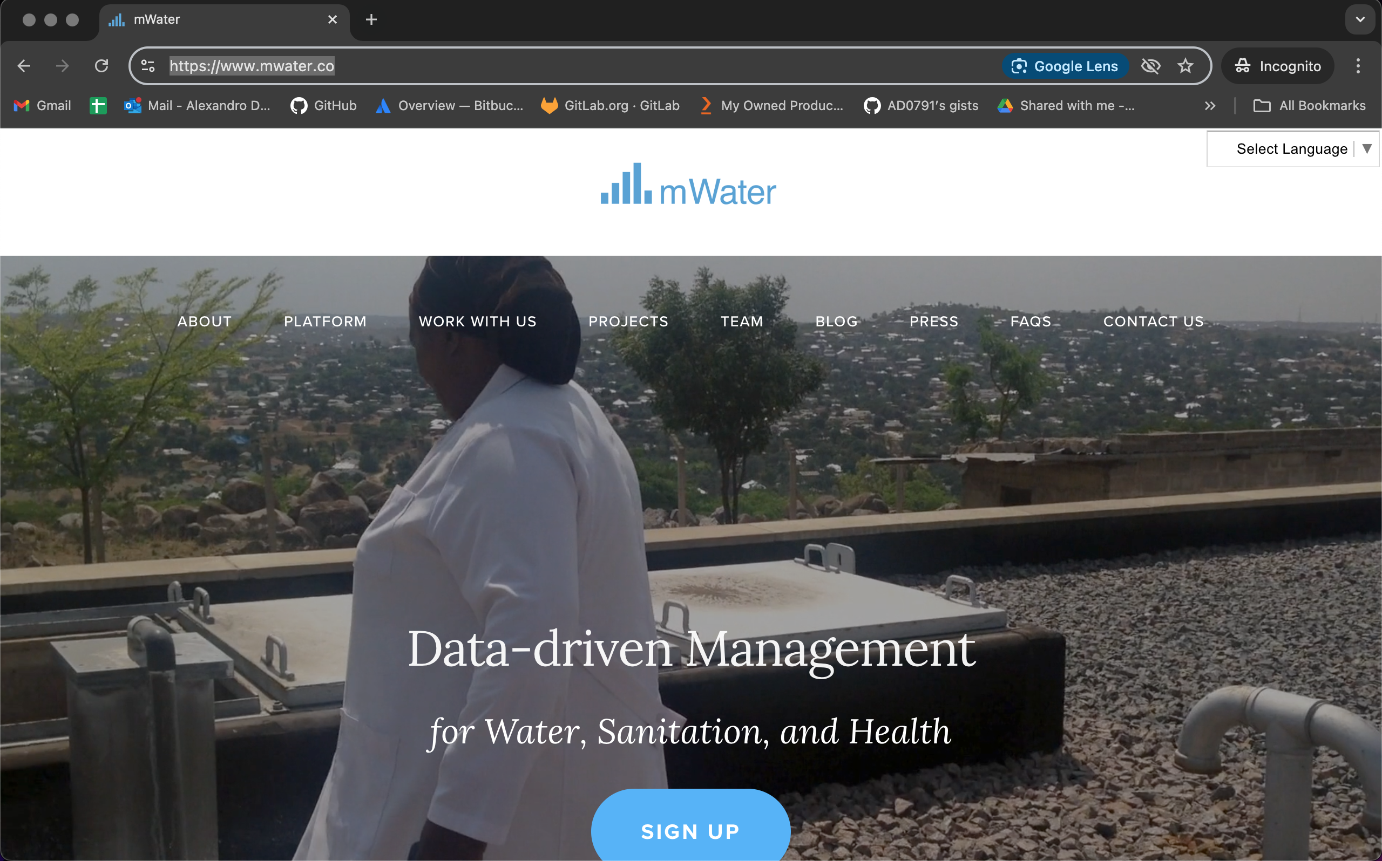
MWATER
CONNECTION LINK: https://www.mwater.co

Slide 5
main page
You can choose your language

Slide 6
SIGNUP
What are the steps?
Connection with the mWater plateform
The front page presentation
The signup form
The home page presentation

Slide 7
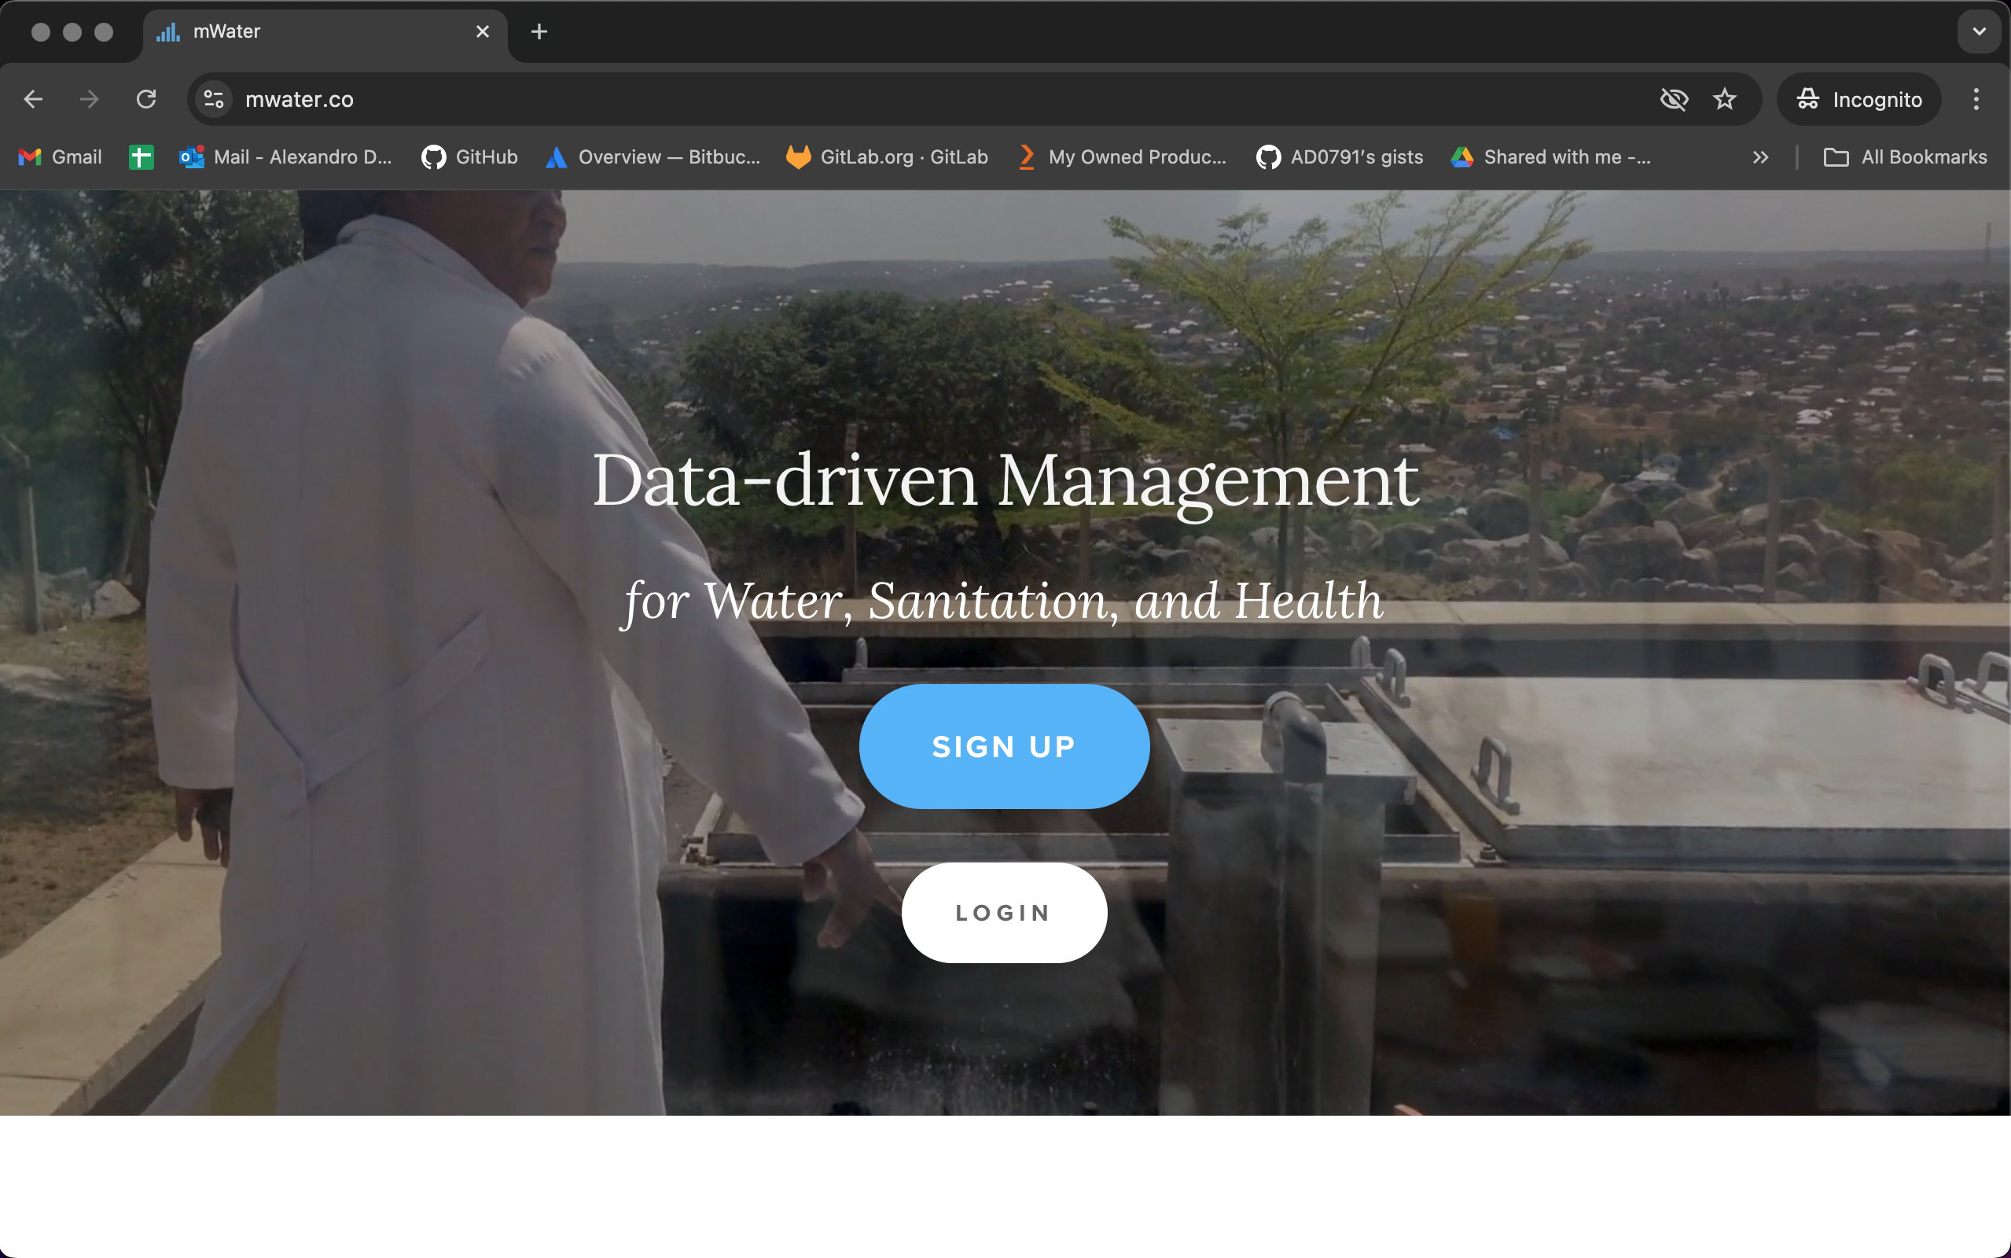
Main Page
Now please click to access the sign up page.

Slide 8
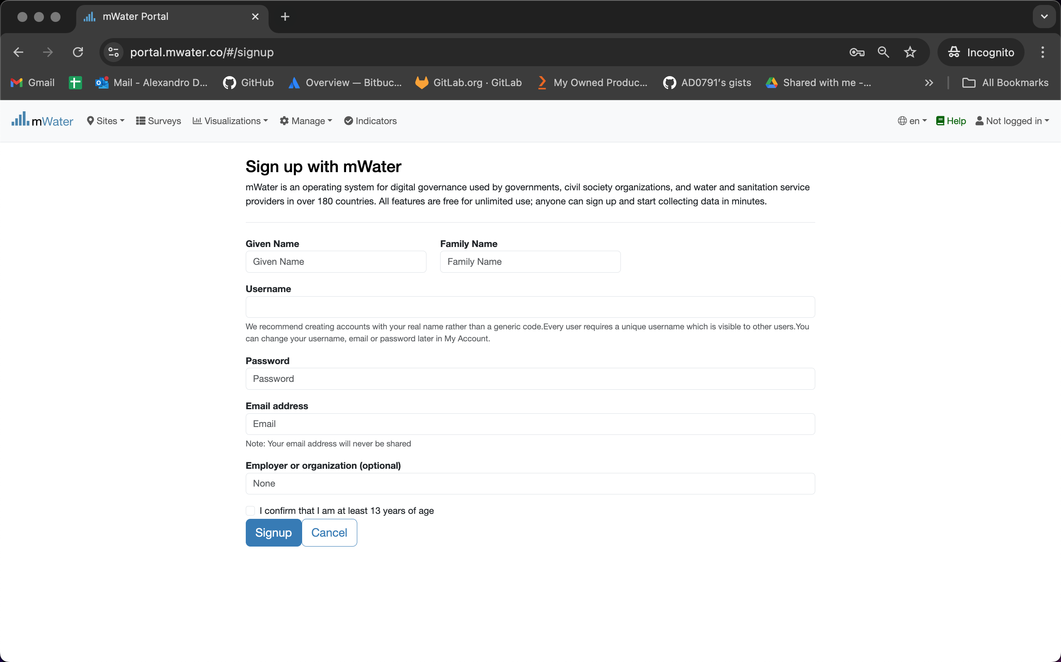
The signup page
This indicate that you are not logged in the system yet.
You can change the language here. Right now it indicates that this page is in english.
Fill, respectivelly, with you first name and last name.
The username should be: “first_name.last_name” like : alexandro.disla
Fill you password and a functional email address.
Organizaition is HANWASH. Click on the confirm button.
Click on the signup button when you are done.

Slide 9
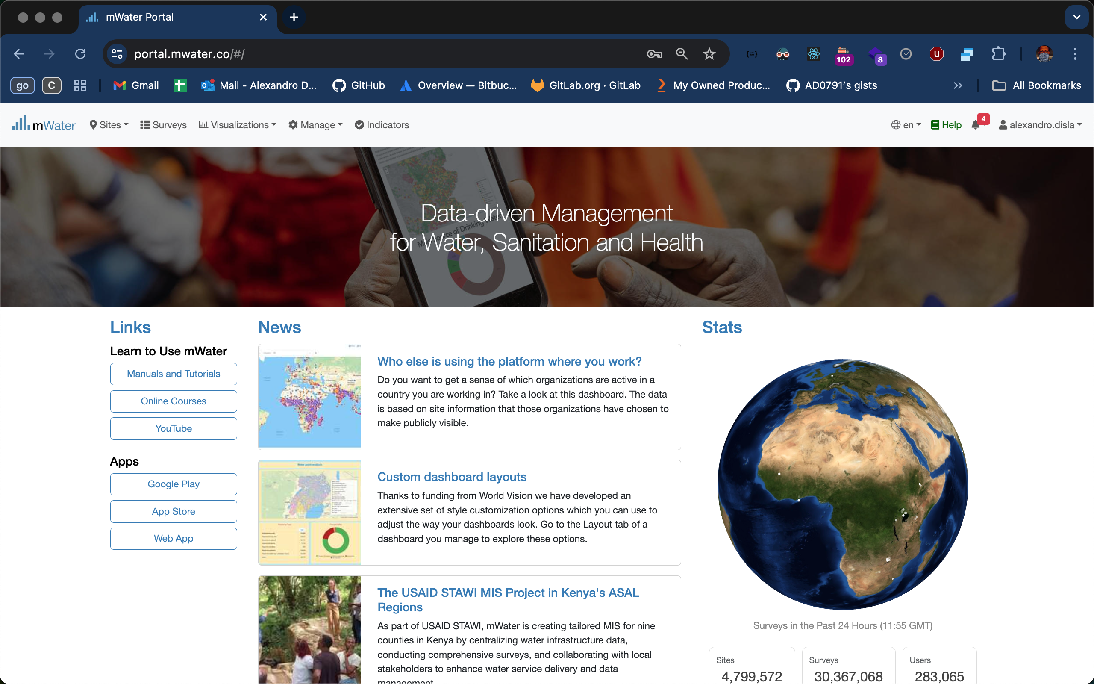
Mwater Homepage
This will indicate you username. The process is done and complete.

Slide 10
Thank You !!!
PLEASE FEEL FREE TO CONTACT ME BY :
Email / alexandro.disla@hanwash.org
Whatsap or Phone / +50941483700

Slide 11
Login
What are the steps?
Connection with the mWater plateform
Access the login page
Fill the login form
The mWater home page

Slide 12
Main Page
Click on the login button to access the login page.

Slide 13
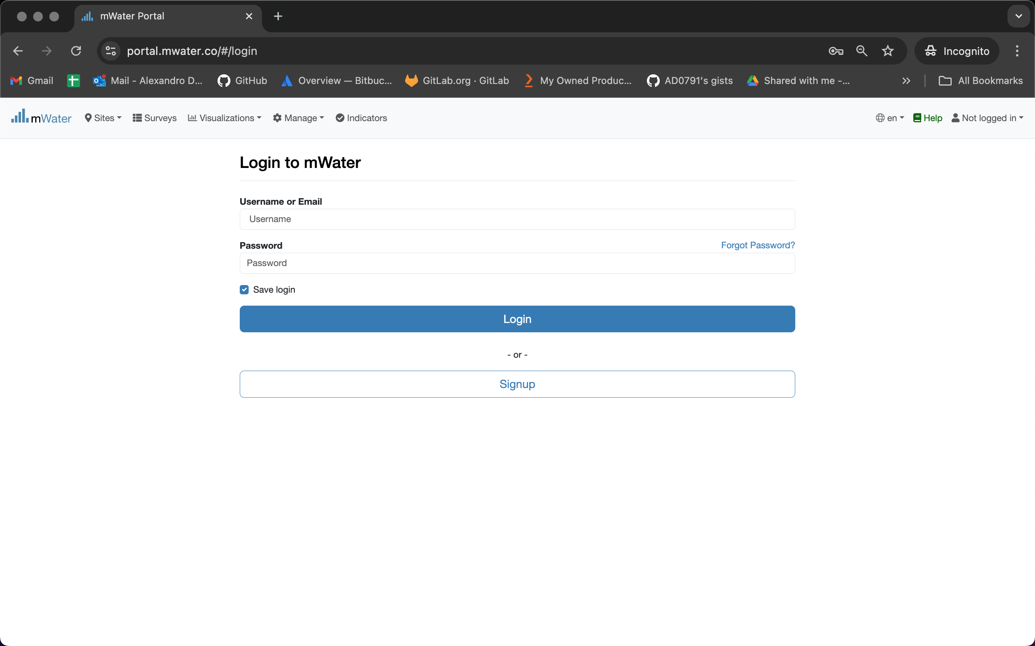
Login page
Fill your username or you email. Fill your password.
Click on the login button when you are done.

Slide 14
Mwater Homepage
This will show you username. The process is done and complete.

Slide 15
Change the Password
What are the steps?
You are logged into mwater.
Access your account page.
Enter the change password view.
Confirmation email of new password.

Slide 16
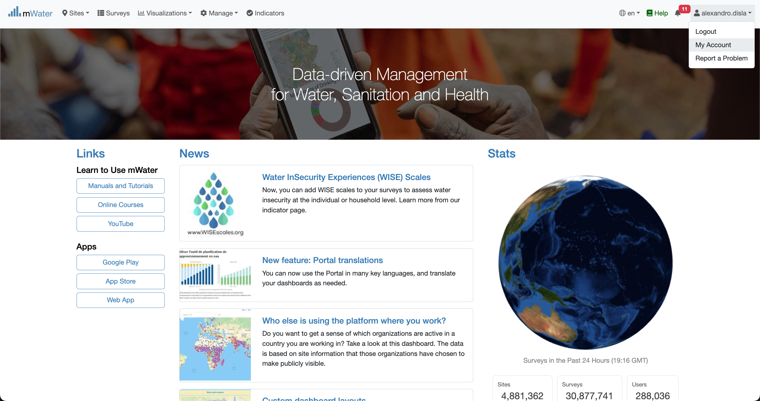
Process for password change
You are already logged in. You might be into the HANWASH Home. What matters remains that you have access to your account page.

Slide 17
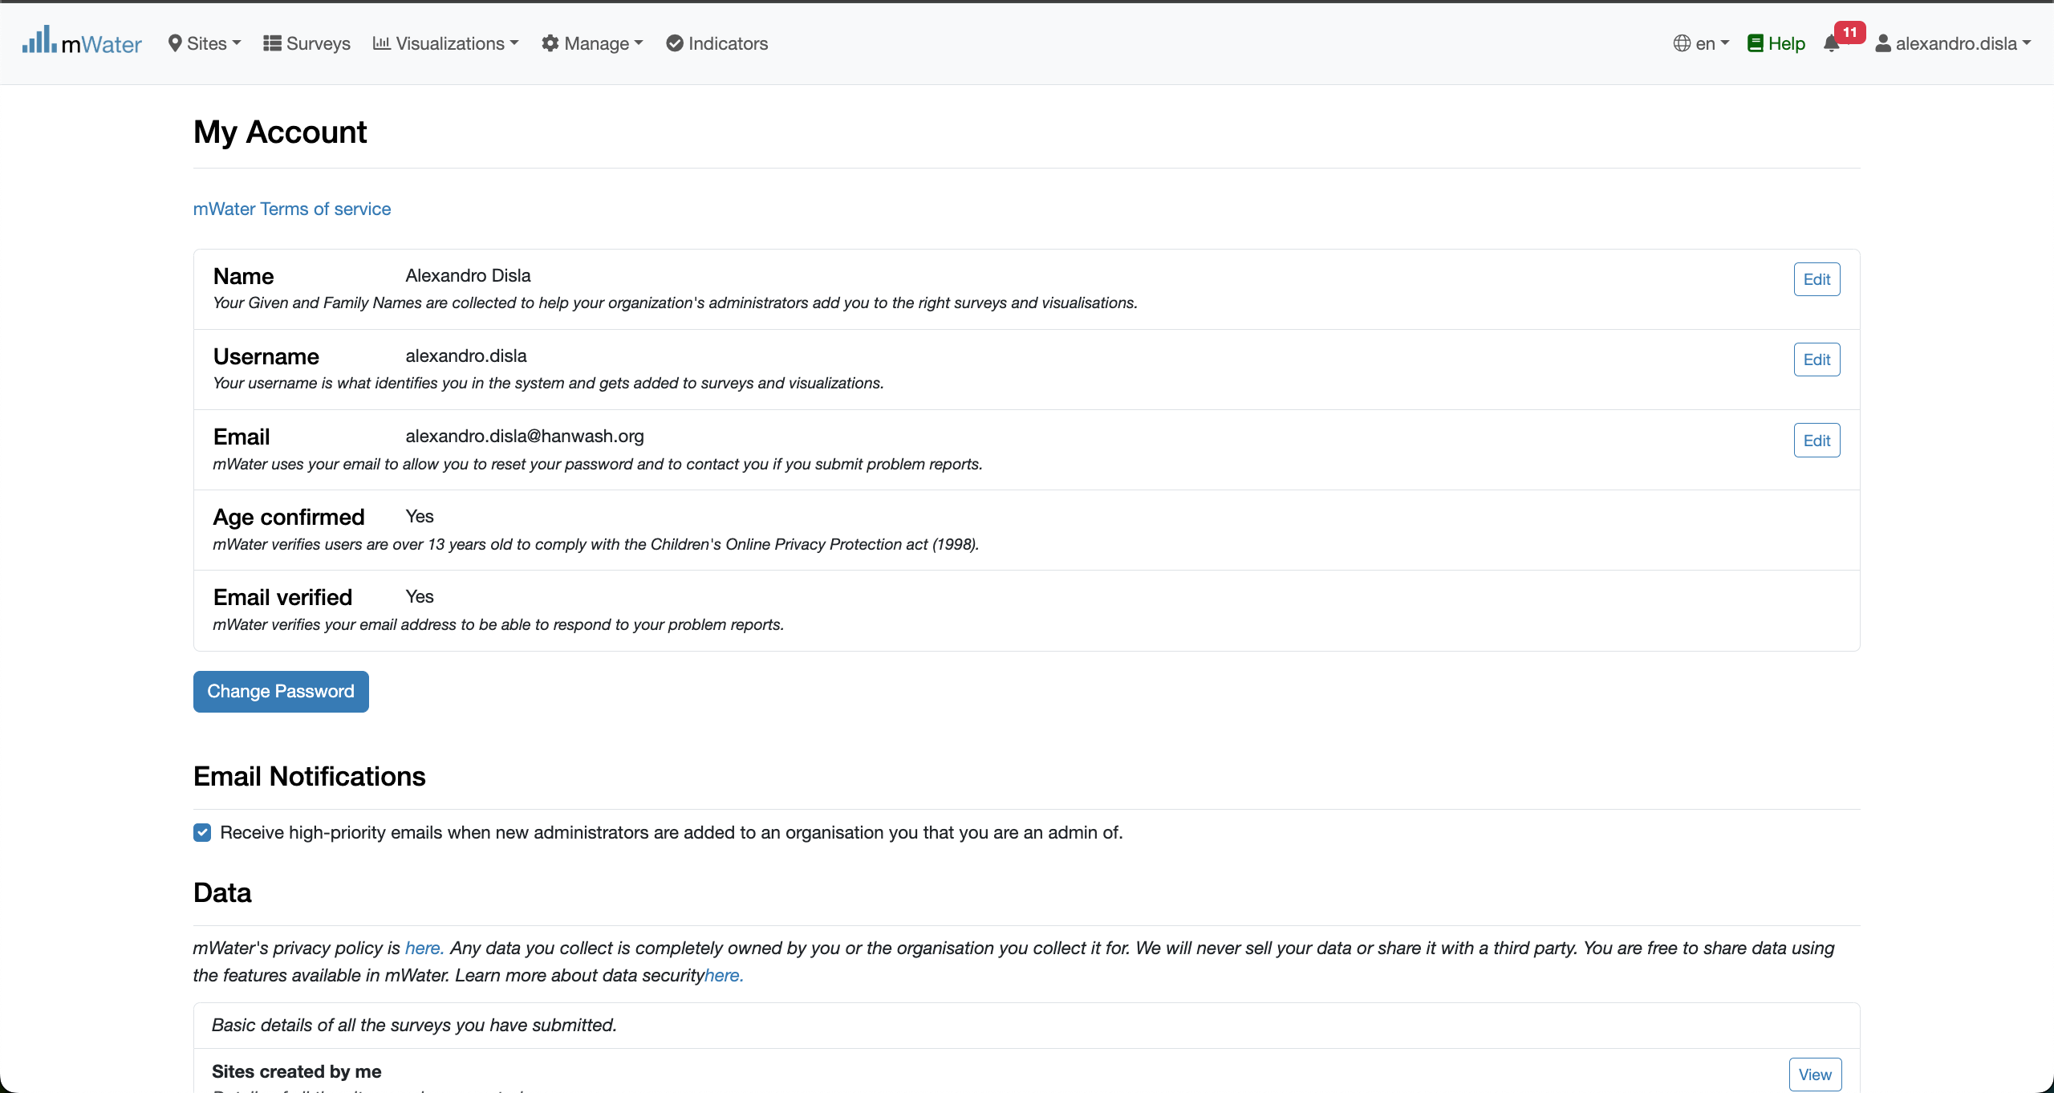
Process for password change
Now you can click on the “Change Password” button. The modal view will pop up with the field for the password change.

Slide 18
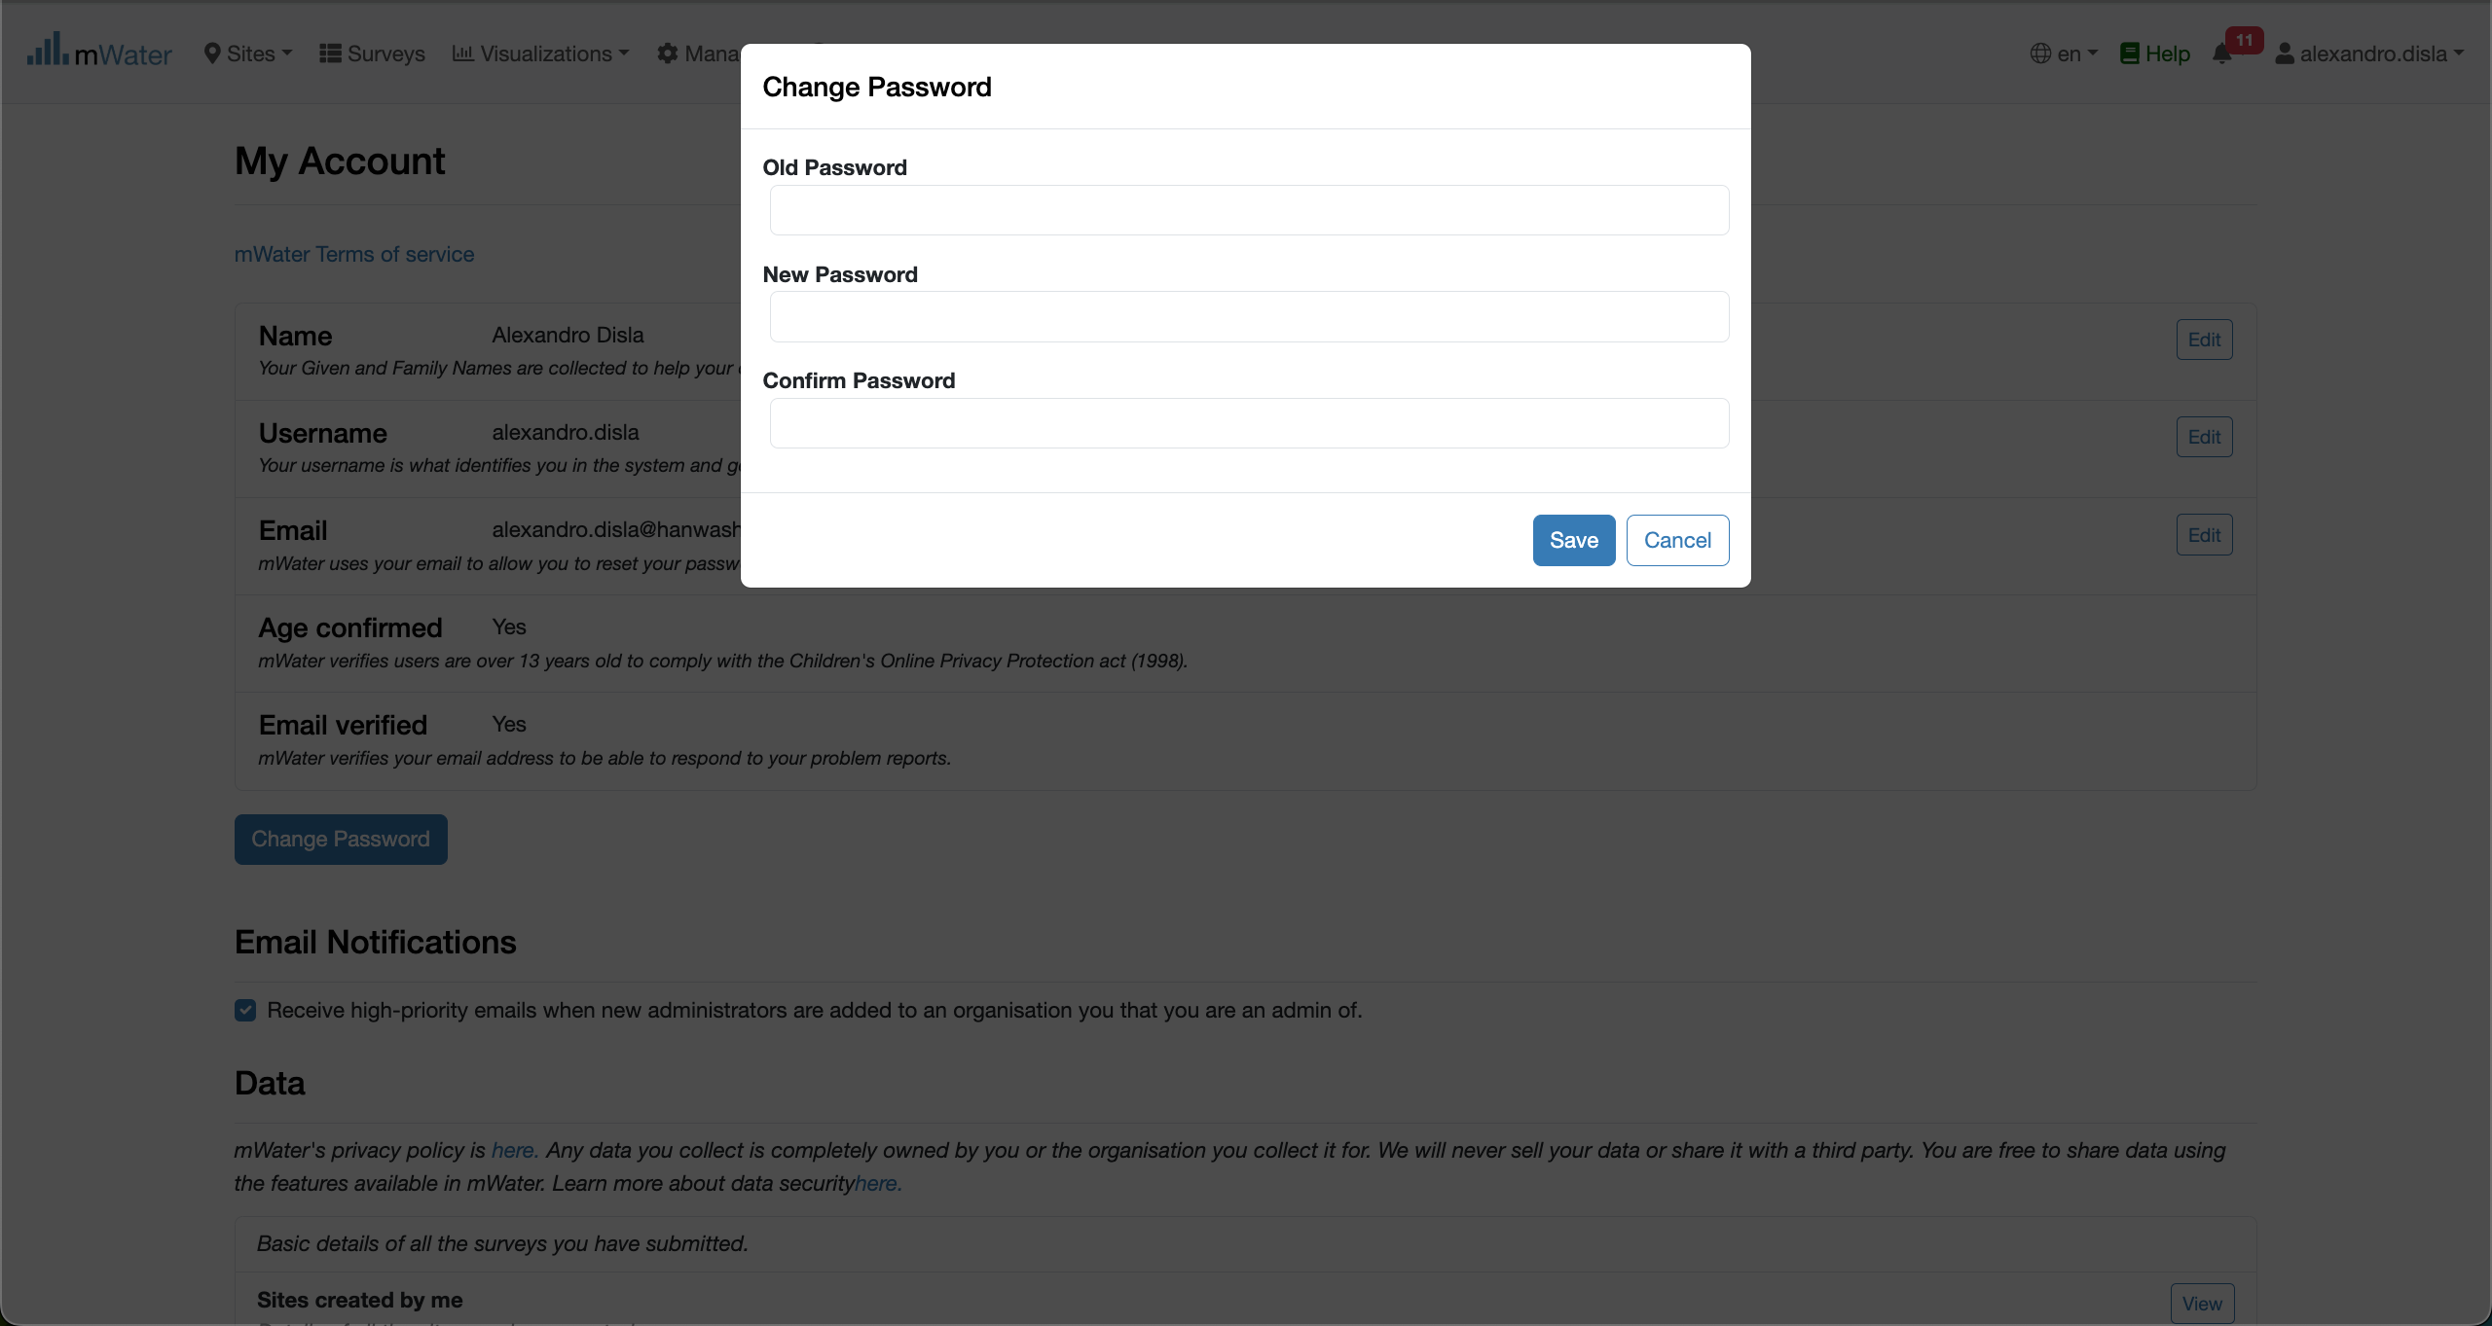
Process for password change
You need to enter your old password first. Then you will need to enter your new password twice. You click “save” when you are done.
A green notification will appear. Signalling that the password was change successfully.

Slide 19
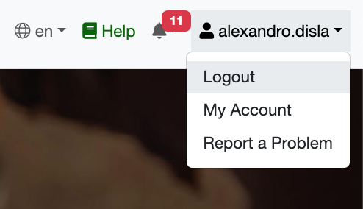
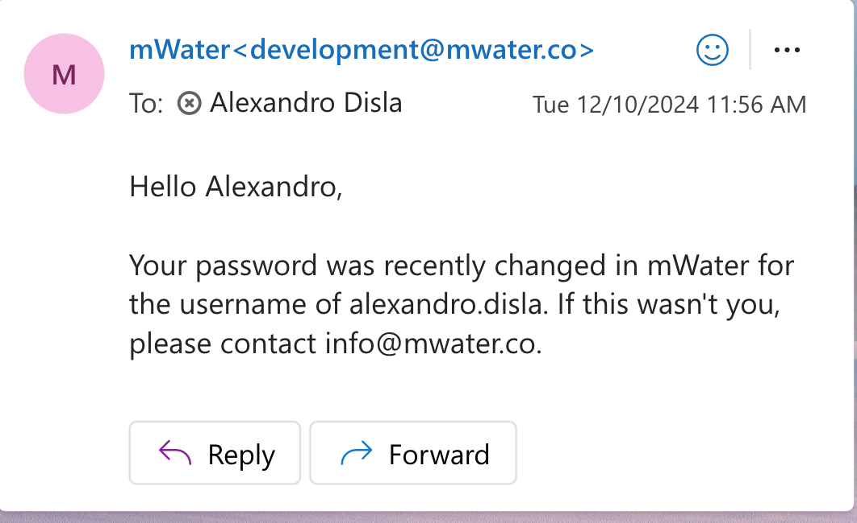
Process for password change
At this point you have option to logout and reconnect with your new password to make sure everything is ok.
However besides the green confirmation button. You will receive an email notification, just like this, with the confirmation of the password change success.

Slide 20
Thank You !!!
PLEASE FEEL FREE TO CONTACT ME BY :
Email / alexandro.disla@hanwash.org
Whatsap or Phone / +50941483700

